Slide 1
NTrace Dynamic Function Boundary Tracing for Windows on IA-32
Oct 13, 2009
16th Working Conference on Reverse Engineering
Johannes Passing, M.Sc.
Hasso Plattner Institute at U Potsdam, Germany

Slide 2
NTrace at a glance
Tracing for Windows kernel and user mode components
Running on retail Windows systems
No source code required
No reboot required
Notes:
collect, write to file, create call graphs, gain critical insight into components we do not know/have sources for

Slide 3
Agenda
Dynamic Function Boundary Tracing
Overview
Implementation Strategies
NTrace
How NTrace captures events
Implementation highlights
Performance Evaluation

Slide 4
Dynamic Function Boundary Tracing
Function Boundary Tracing
Tracing function entry and exit
Key Benefits of Dynamic Function Boundary Tracing
No source code and rebuild required
‘On the fly‘ instrumentation
Key areas of application
Debugging production systems
Foundation for reverse engineering tools

Slide 5
What makes a good dynamic FBT tool?
Low Runtime Overhead
Usage on production systems requires minimal slowdown
Influences timing behavior
High Coverage
Percentage of functions which can be instrumented
Low Risk
Intrusiveness, danger of introducing faults

Slide 6
Implementation strategies (1/3)
Leveraging CPU features
E.g. Branch Trace Storage, Instruction Based Sampling
High coverage, low risk, but...
High overhead (too fine grained)
Modifying the environment
E.g. IAT/SSDT/Vtbl patching, OSR IRP Tracker
Low risk, low overhead, but...
Low coverage

Slide 7
Implementation strategies (2/3)
Dynamic compilation/translation
E.g. Shade, DynamoRIO, Pin, Valgrind
Low overhead, may achieve high coverage, but...
High risk (reliance on IA-32 disassembly)
Injecting trap-generating instructions (e.g. int 3)
E.g. DTrace (IA-32), KernInst (IA-32)
High coverage, low risk, but...
→ High overhead (traps are expensive)

Slide 8
Implementation strategies (3/3)
In-place code modifications
E.g. DTrace (SPARC), KernInst (SPARC), Detours
Potentially high coverage, low risk, low overhead, but...
not easy to get right on IA-32 (and Windows)

Slide 9
Key challenges of IA-32
IA-32 uses a variable-length instruction set
Disassembly is error-prone
Smallest jmp occupies 2 bytes, push ebp only 1
Shifting instruction boundaries is very dangerous due to preemption and interruption
Need to adhere to Intel’s strict requirements on runtime code modification
Issue serializing instruction (barrier) after code modification
Stall other cores/CPUs in an multiprocessor environment
Notes:
recursive traversal, linear sweep

Slide 10
Key challenges of Windows NT
Kernel is re-entrant and preemptive
Heavily multi-threaded
Structured Exception Handling (SEH)
Ubiquitous in both user and kernel mode
→ Unwinds are function exits, too!
Only public debugging symbols available
No kernel modifications possible

Slide 11
Agenda
Dynamic Function Boundary Tracing
Overview
Implementation Strategies
NTrace
How NTrace captures events
Implementation highlights
Performance Evaluation

Slide 12
Overview
Idea
Leverage properties of hotpatchable images
Use in-place code modification to capture function entries
Replace return address to capture function exits
Integrates with SEH infrastructure to capture unwinds
Supports both kernel and user mode
Supports SMP
Runs on retail Windows versions (Svr03 SP1 onwards)
Public debugging symbols suffice

Slide 13
Hotpatchable images
Part of Hotpatching
Introduced in Svr03 SP1 (DDK 3790.1830)
Almost all OS images are hotpatchable
Both user and kernel mode
Compiler/Linker support: /hotpatch, /functionpadmin
...
retn 10
nop
nop
nop
nop
nop
NtfsPinMappedData:
mov edi, edi
push ebp
mov ebp, esp
mov ecx, [ebp+18h]
mov edx, [ebp+0Ch]
...
...
retn 10
jmp PatchedNtfs...
NtfsPinMappedData:
jmp $-7
push ebp
mov ebp, esp
mov ecx, [ebp+18h]
mov edx, [ebp+0Ch]
...

Slide 14
Capturing function entry and exit
Foo-5:
CallProxy:
Foo:
.
.
.
.
.
.
EntryThunk:
.
.
.
Notes:
Variation of this scheme for
* push immediate
* indirect calls

Slide 15
SEH: Capturing unwinds
Structured Exception Handling implements programmatic, stack based exception handling on IA-32
Linked list of EXCEPTION_REGISTRATION_RECORDs (ERR)
Each must be allocated on the stack (thorough validation)
To be notified about unwinds, a registration is needed
But: Allocating an ERR is not feasible
Solution: Modify existing ERR, use combination of two exception handlers to ‘emulate’ an exception registration

Slide 16
NTrace Architecture

Slide 17
Agenda
Dynamic Function Boundary Tracing
Overview
Implementation Strategies
NTrace
How NTrace captures events
Implementation highlights
Performance Evaluation

Slide 18
NTrace vs. DTrace (IA-32)
Micro benchmark
500 million calls to getpid/NtIsProcessInJob
Very simple system call
IA-32 machine, 4 cores
... running NTrace/Windows Server 2003 SP2
... running DTrace FBT/OpenSolaris 10
Empty Probe

Slide 19
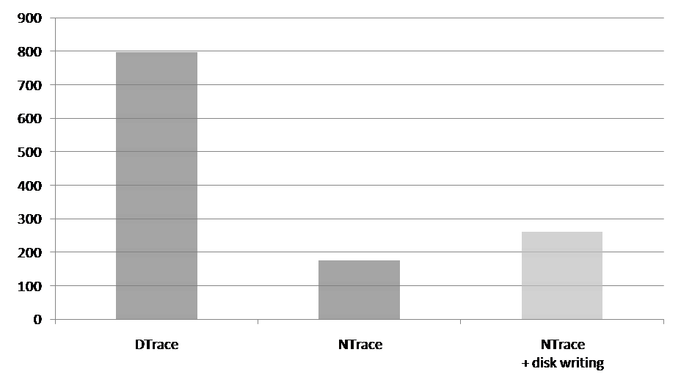
NTrace vs. DTrace (IA-32): Results
Absolute slowdown per traced system call in nanoseconds
NTrace is significantly faster than DTrace FBT (175ns vs. 798ns)
...even when writing all data to disk (262ns vs. 798ns)
...roughly on par with DTrace SPARC
Notes:
Same HW, different OS

Slide 20
Conclusion
NTrace can trace both user and kernel mode Windows NT
Integrates with Structured Exception Handling
Overcomes IA-32 and Windows challenges, achieves
low runtime overhead
low risk
decent to high coverage
Future work: May investigate AMD64 support
D Script-like KTrace frontend is in the works
Notes:
AMD64: different SEH, PatchGuard

Slide 21
Operating Systems and Middleware Group
Hasso-Plattner-Institut
at University of Potsdam, Germany
http://www.dcl.hpi.uni-potsdam.de/
More about NTrace on
http://ntrace.org/

